Slide 1
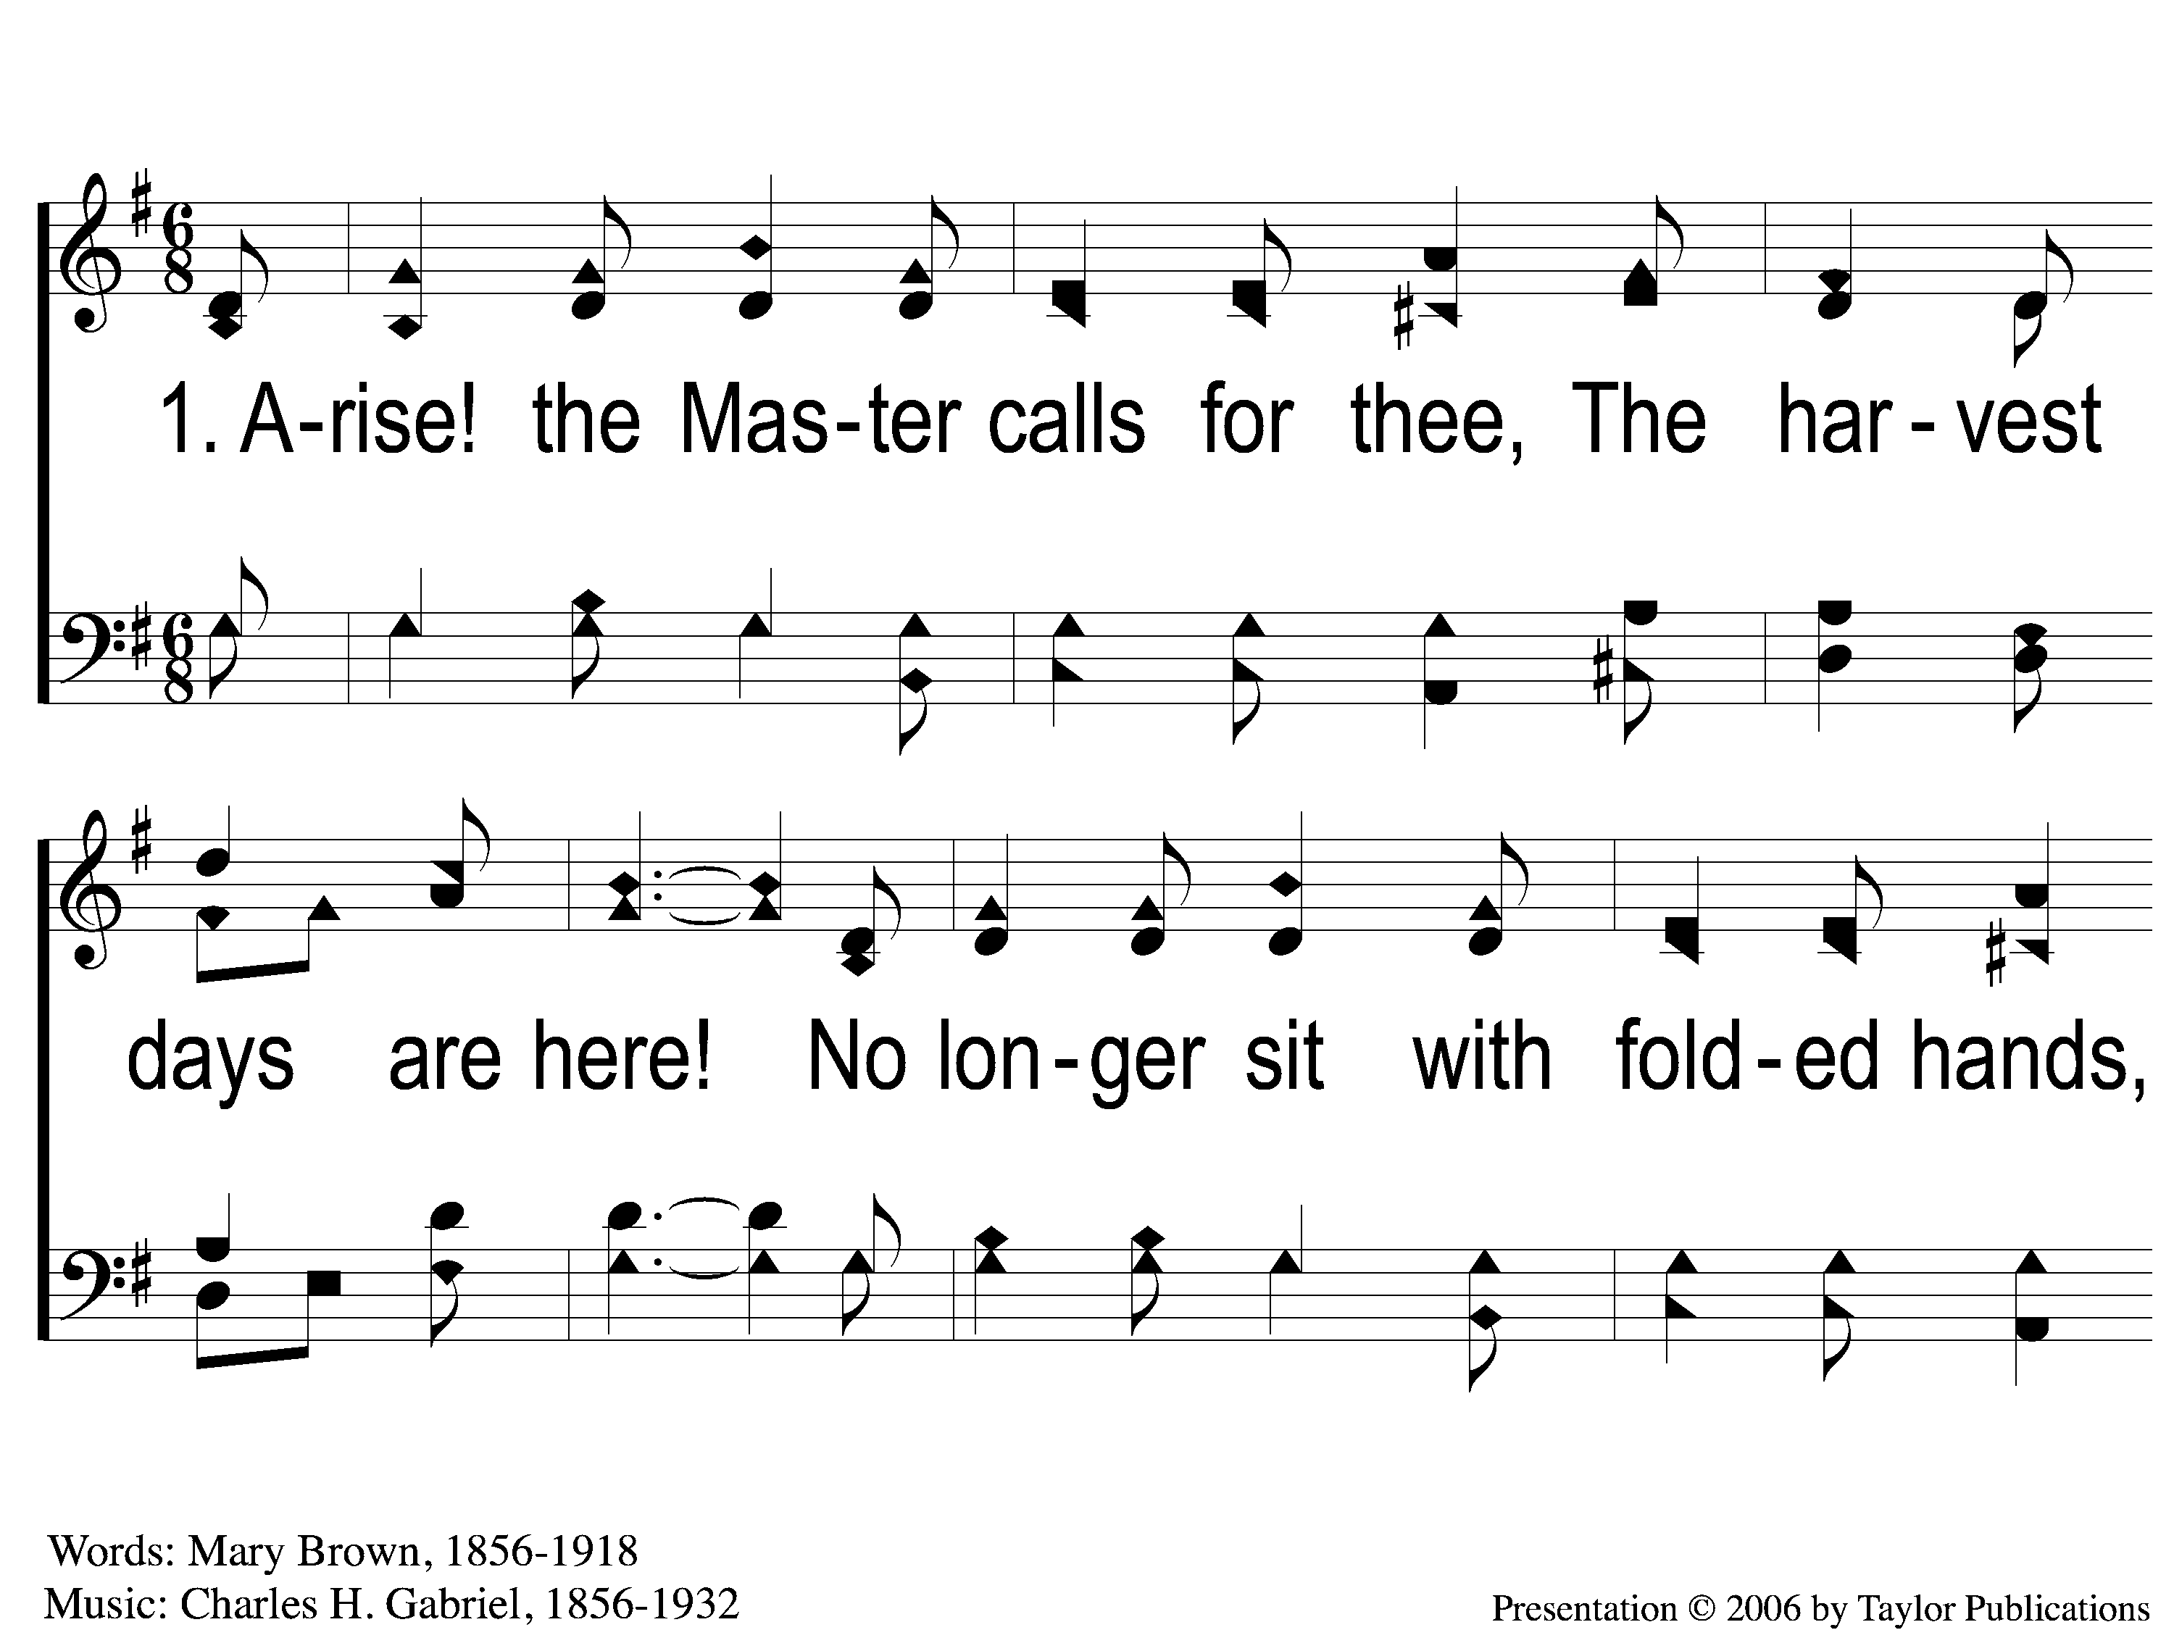
1-1 Harvest Time
Harvest Time
156

Slide 2
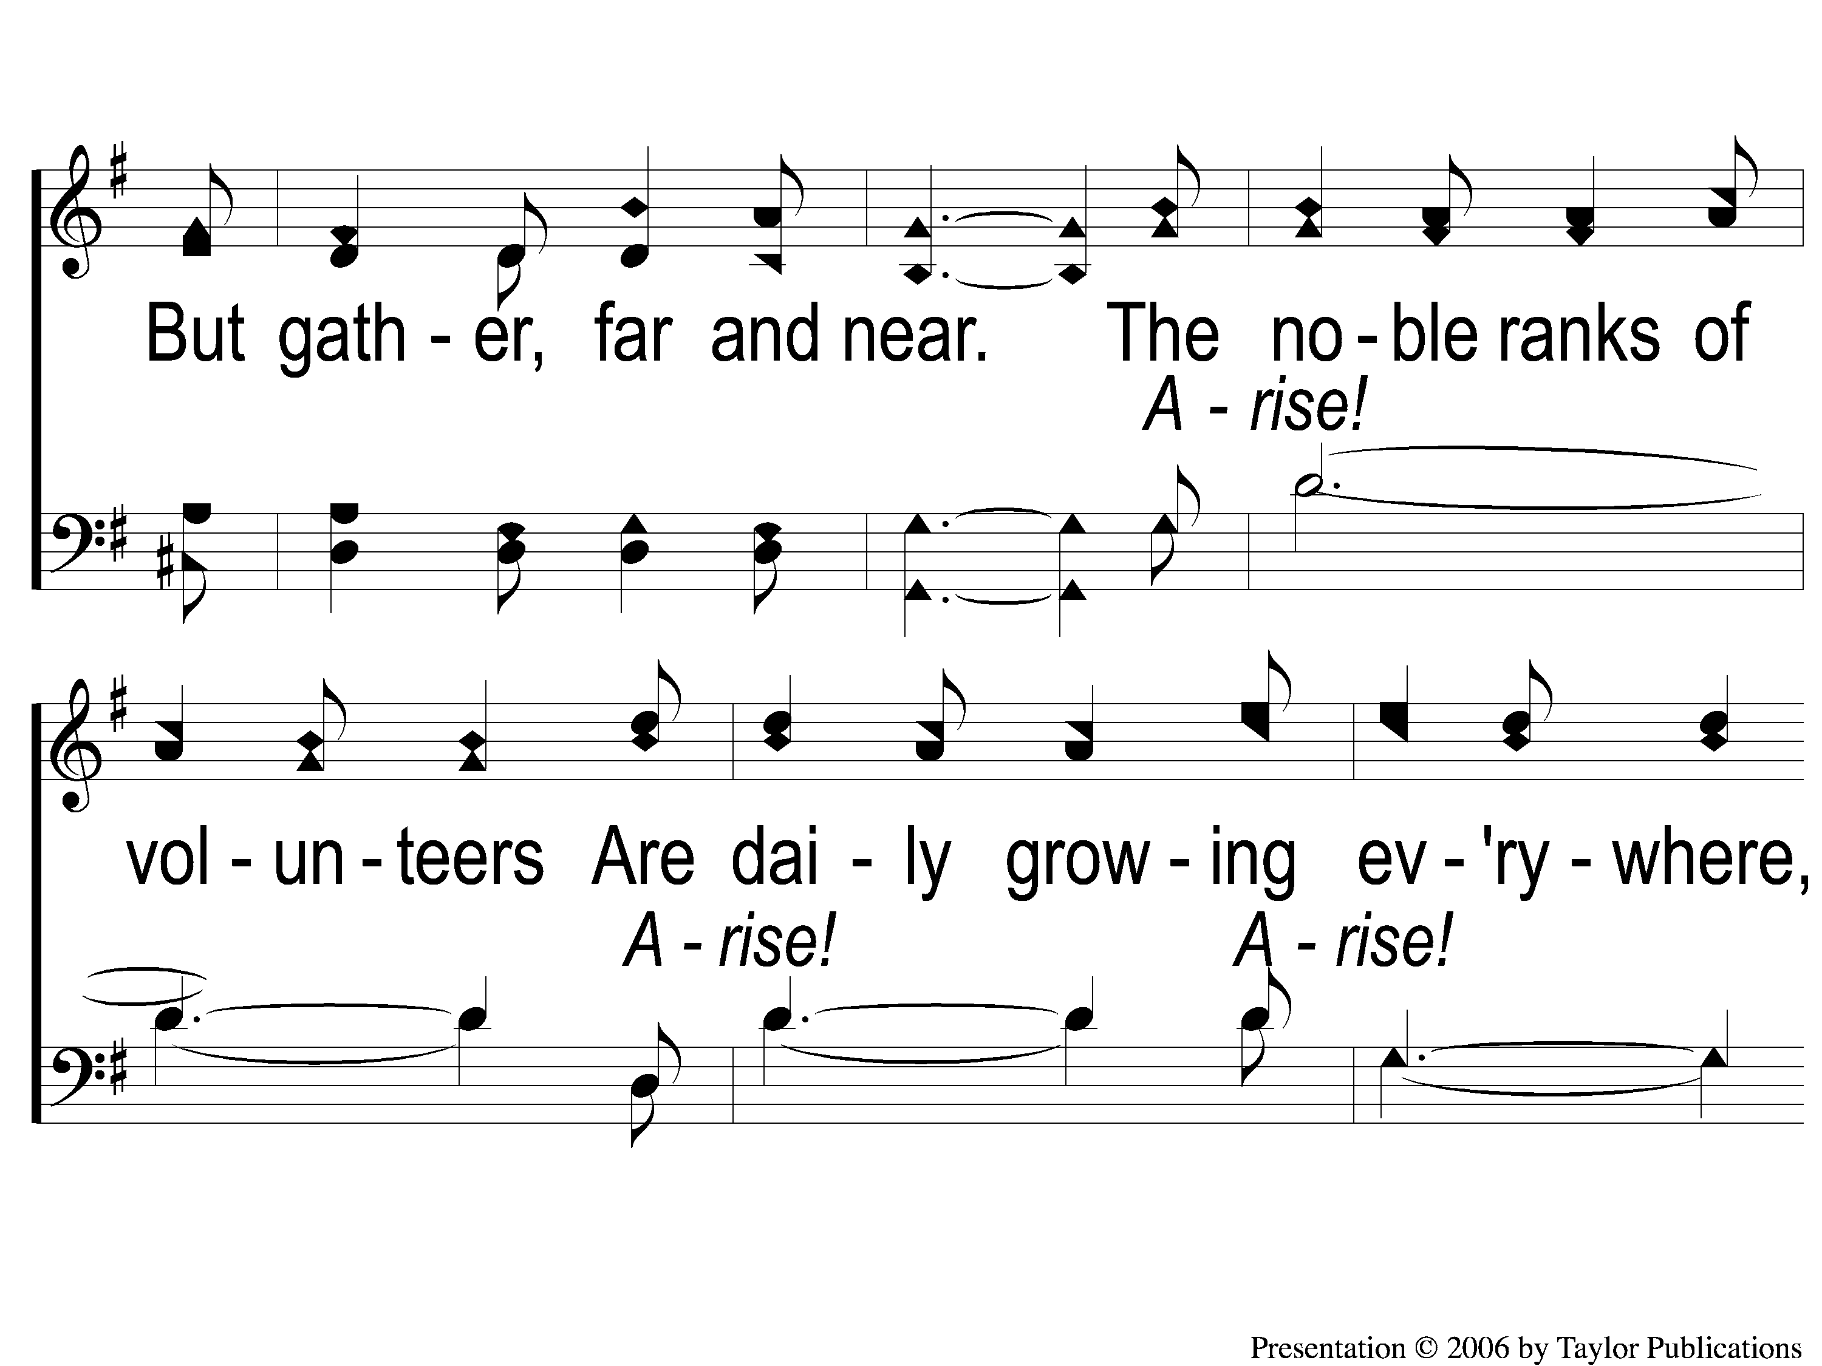
1-2 Harvest Time
Harvest Time
156

Slide 3
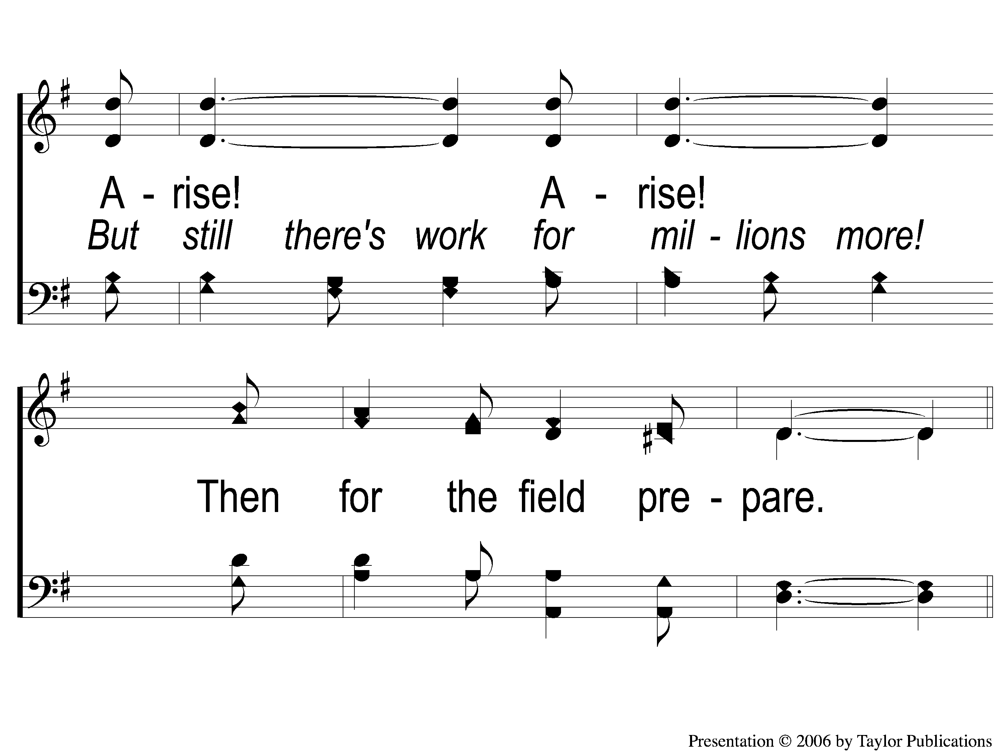
1-3 Harvest Time
Harvest Time
156

Slide 4
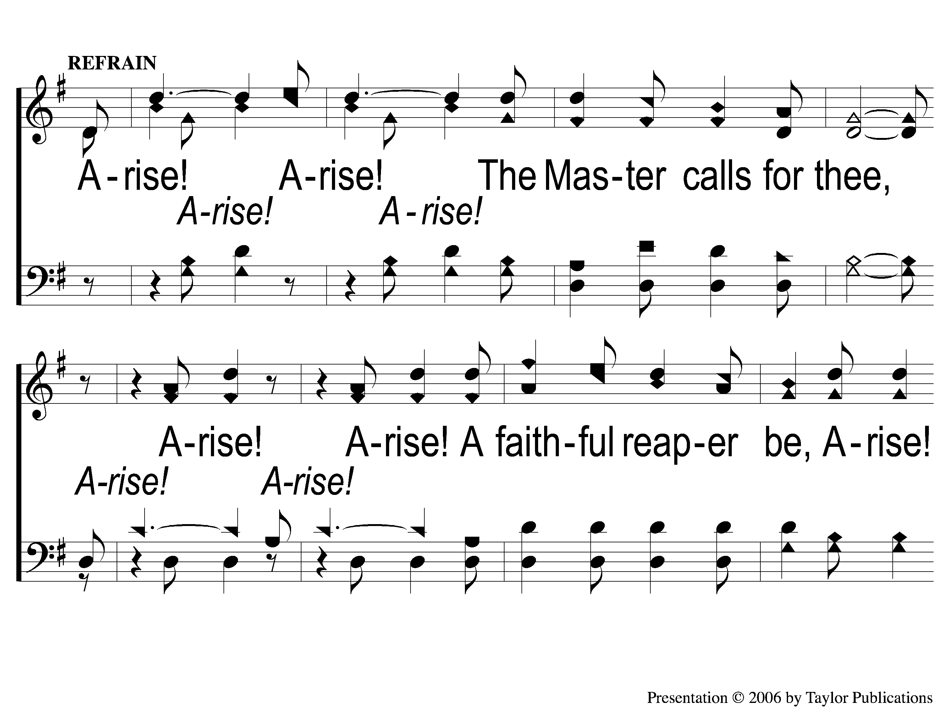
C-1 Harvest Time
Harvest Time
156

Slide 5
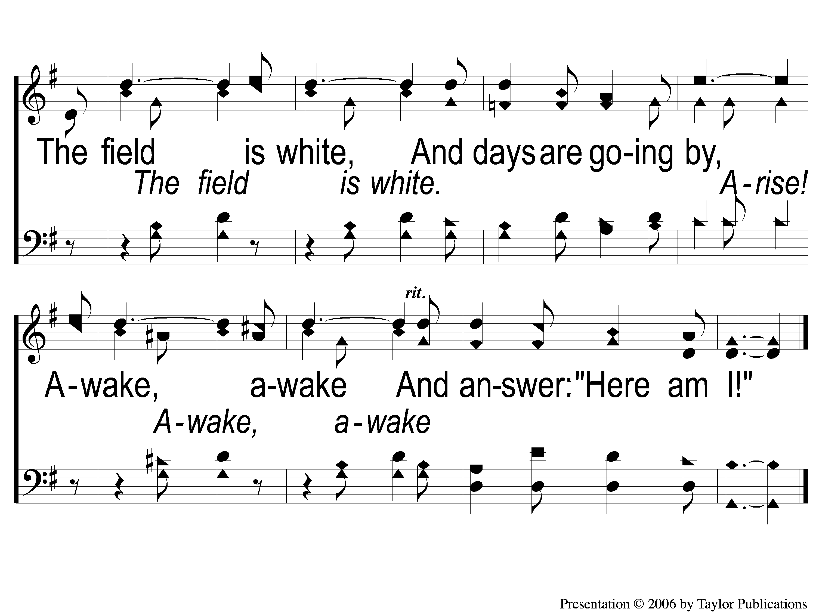
C-2 Harvest Time
Harvest Time
156

Slide 6
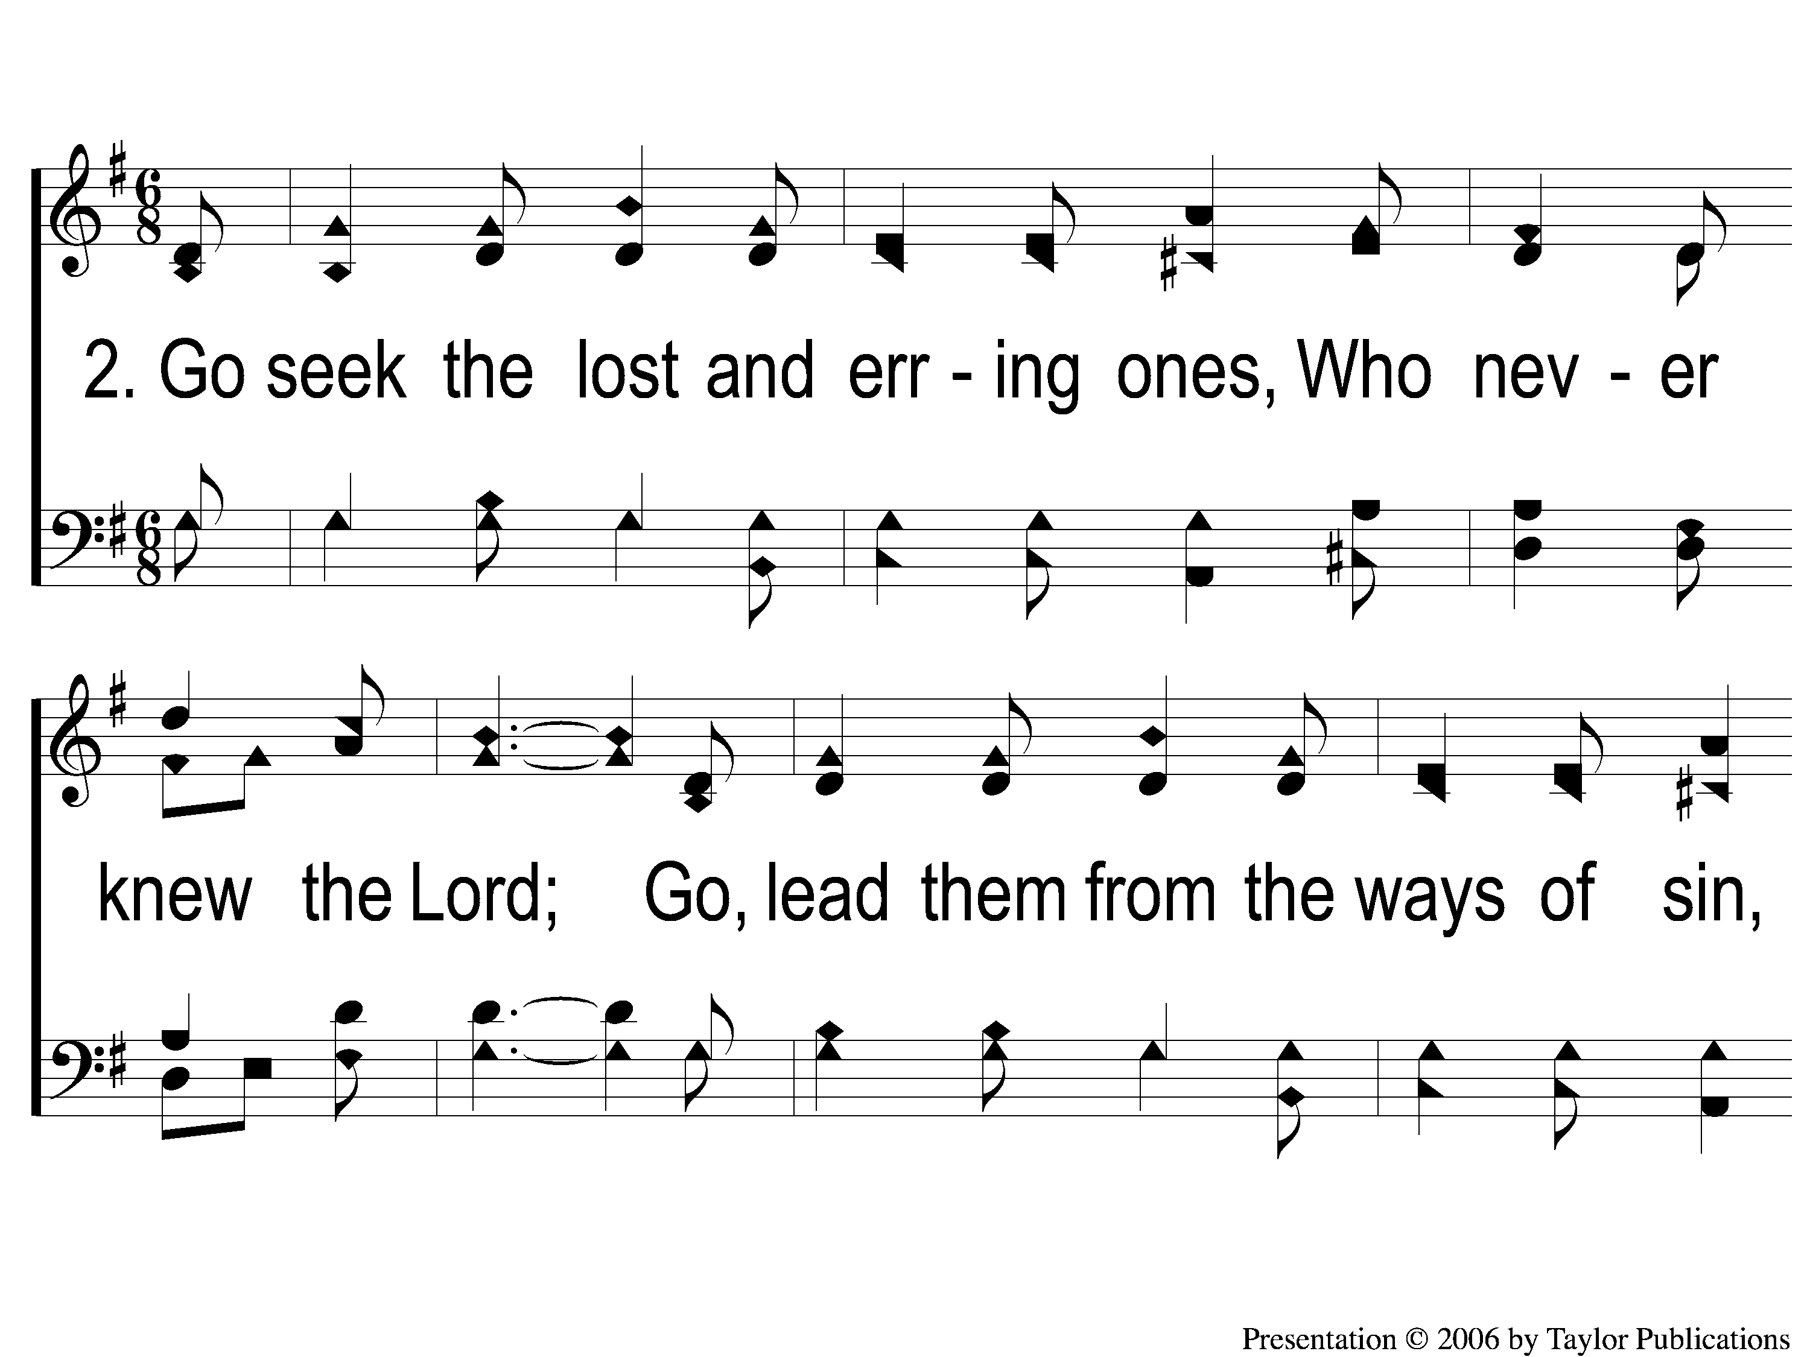
2-1 Harvest Time
Harvest Time
156

Slide 7
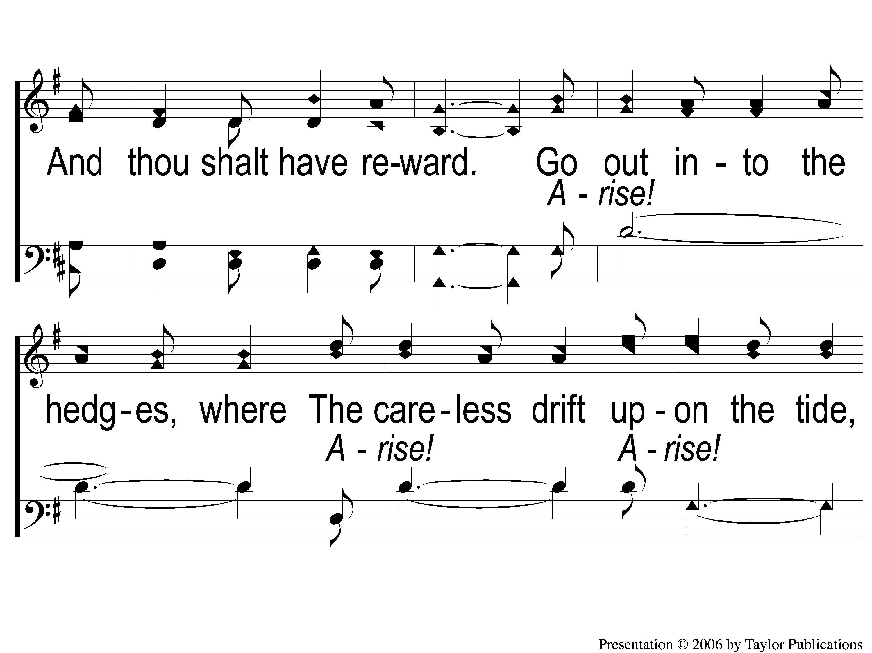
2-2 Harvest Time
Harvest Time
156

Slide 8
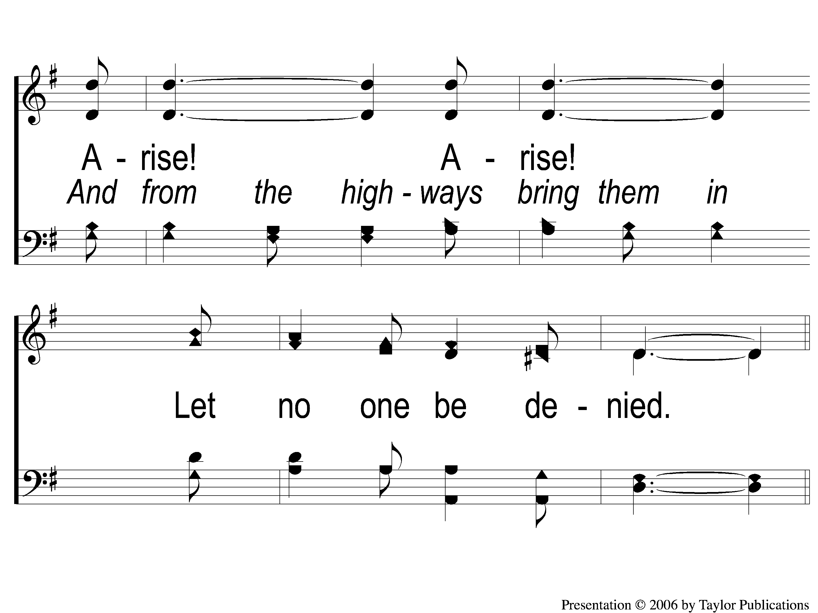
2-3 Harvest Time
Harvest Time
156

Slide 9
C-1 Harvest Time
Harvest Time
156

Slide 10
C-2 Harvest Time
Harvest Time
156

Slide 11
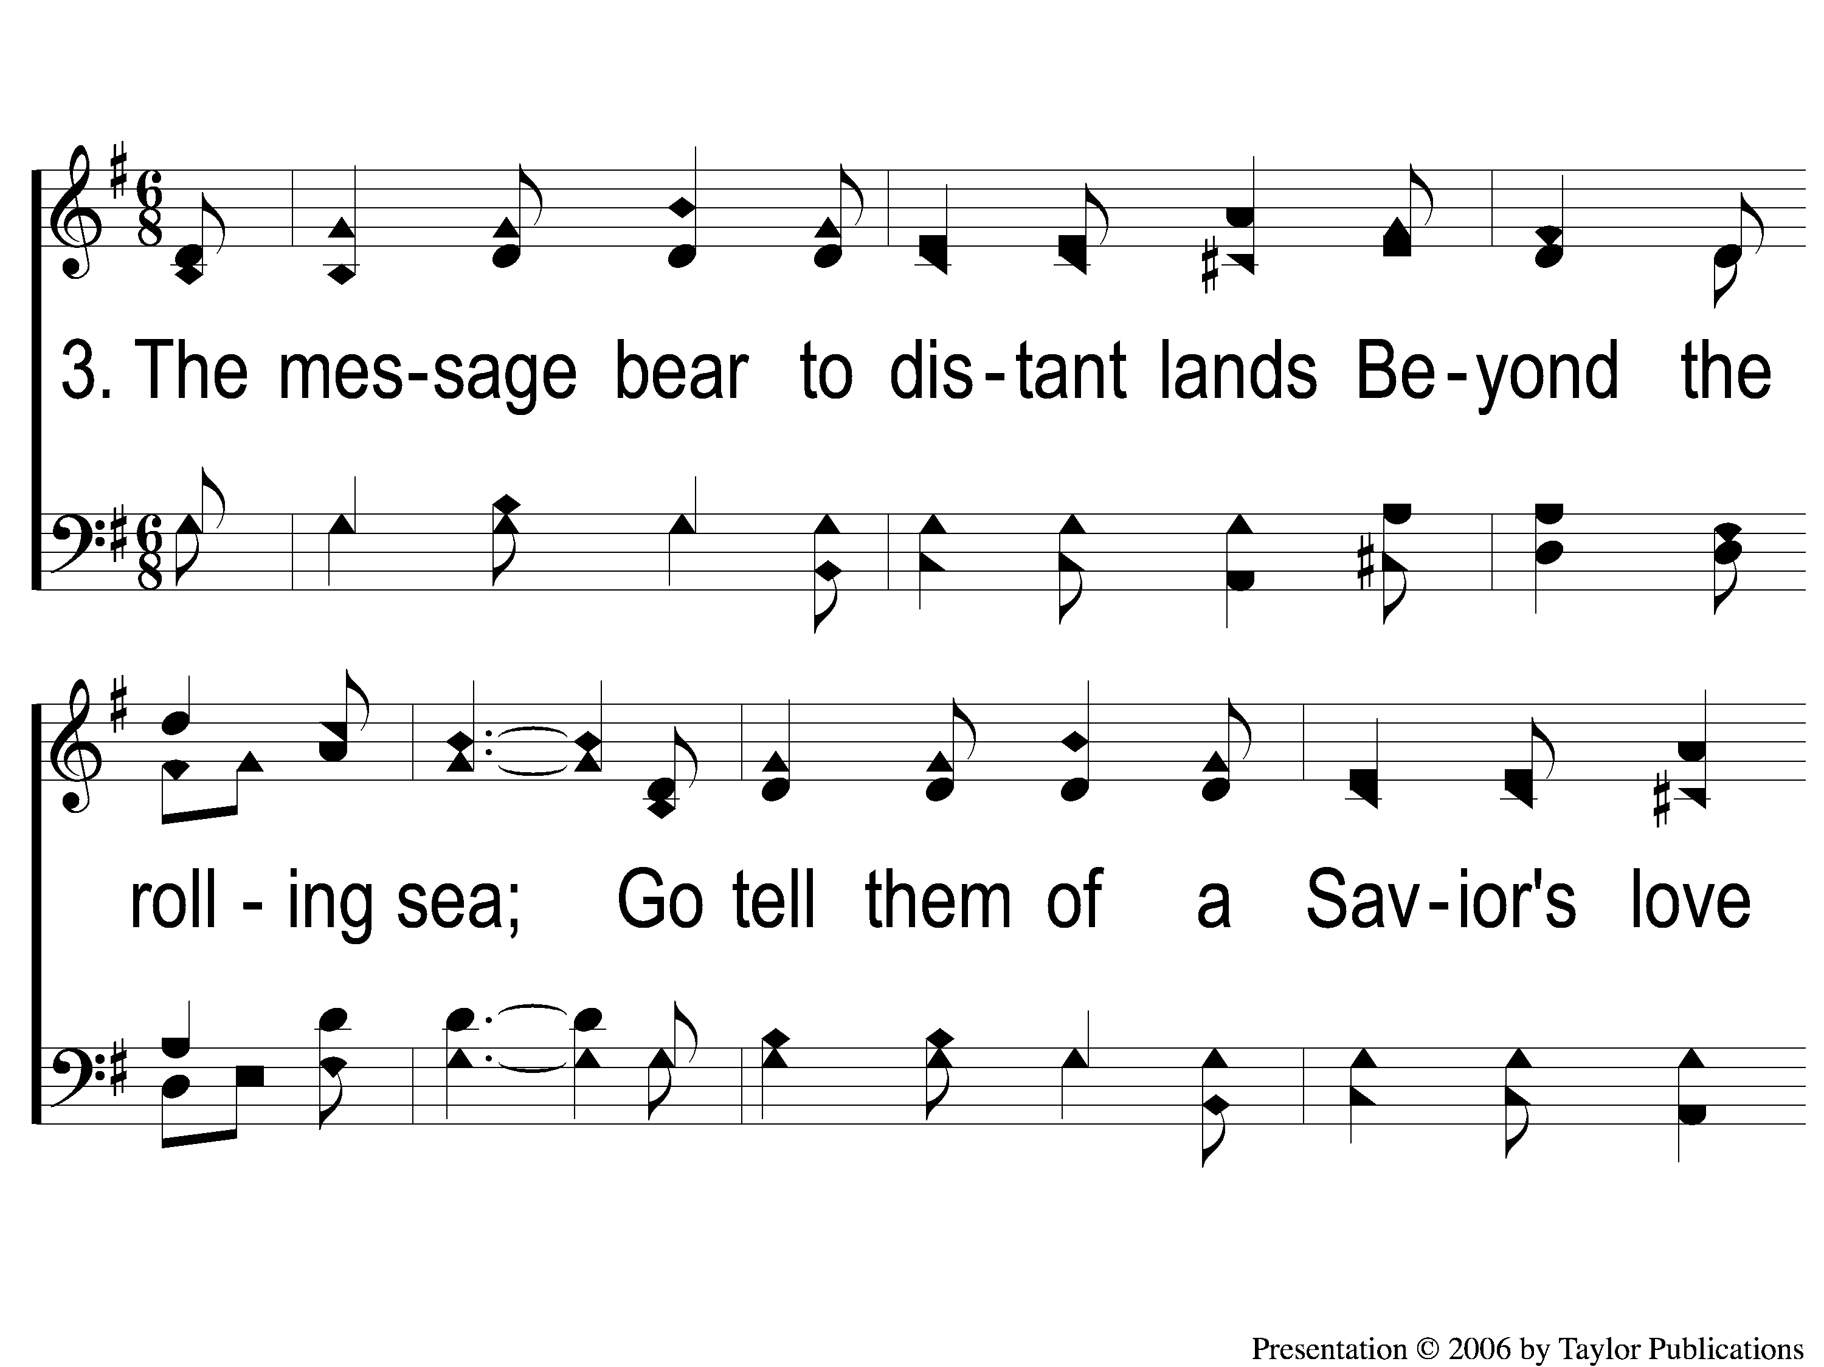
3-1 Harvest Time
Harvest Time
156

Slide 12
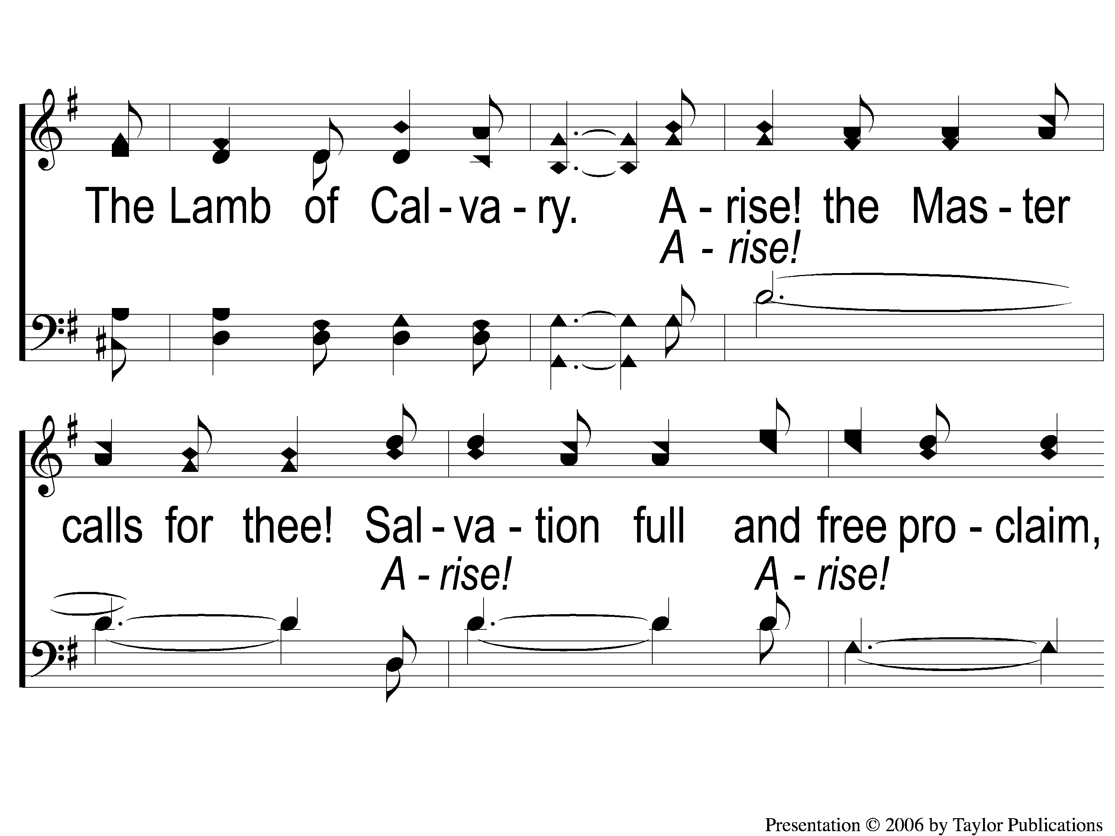
3-2 Harvest Time
Harvest Time
156

Slide 13
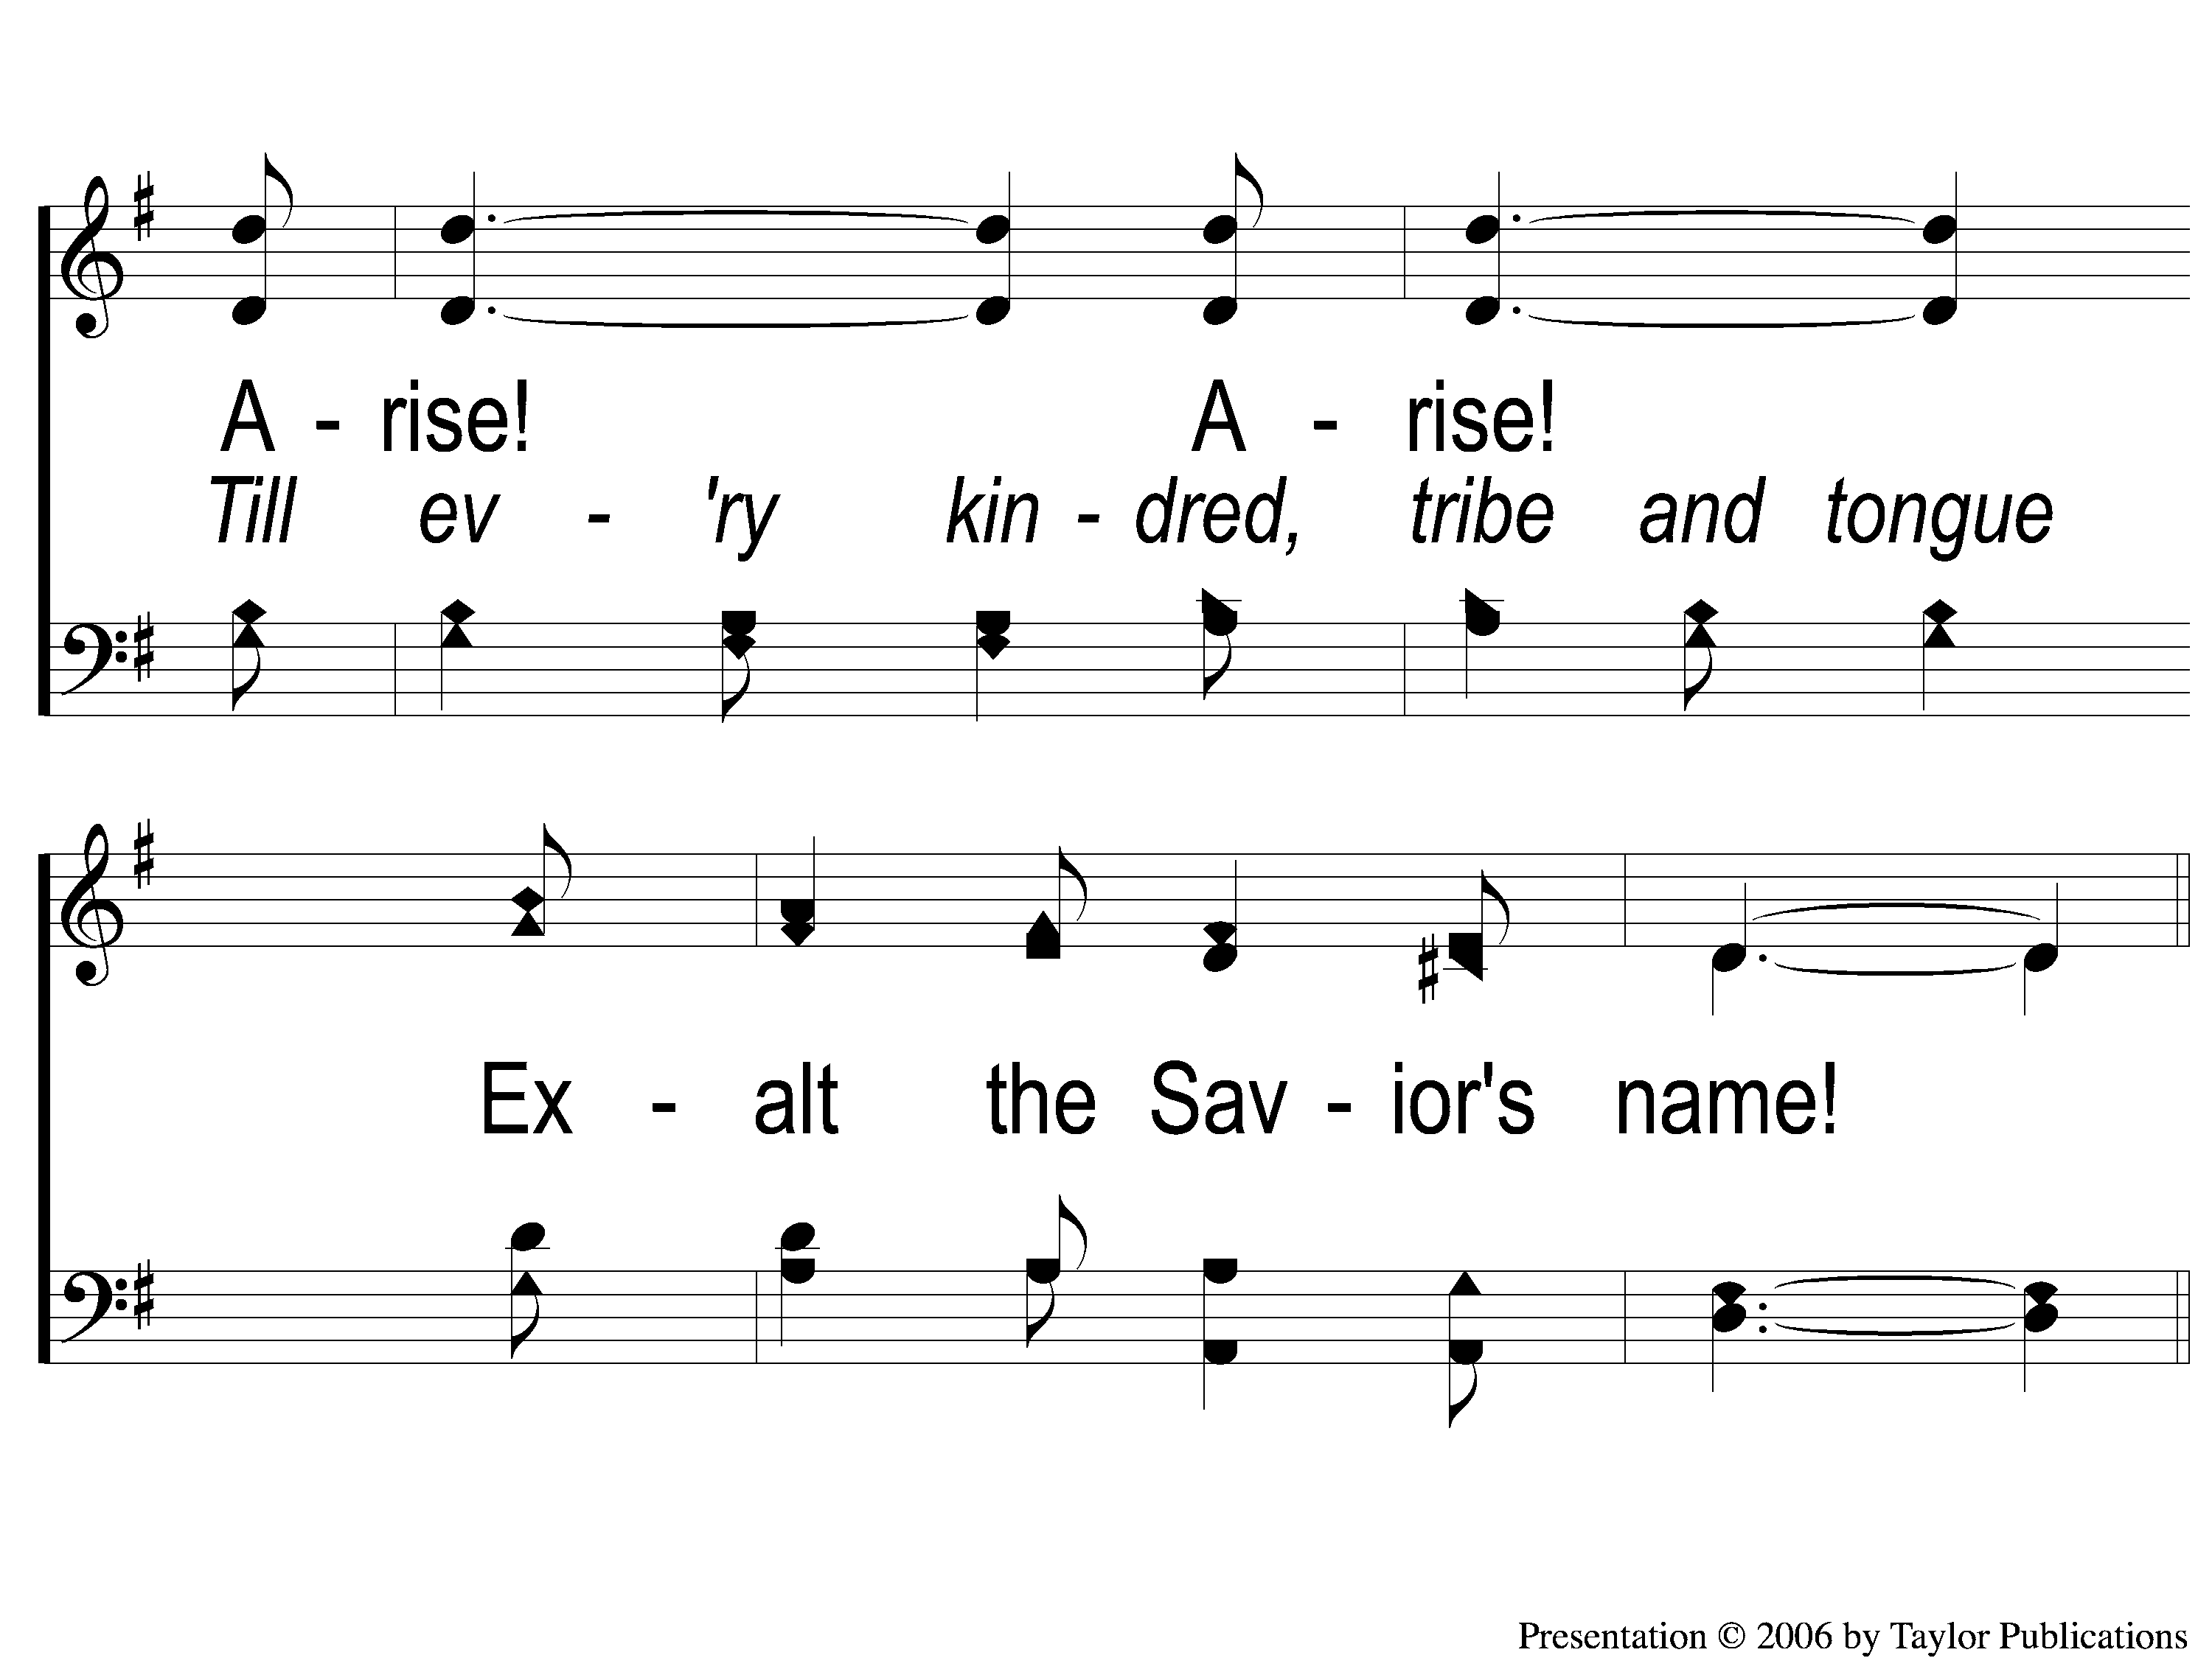
3-3 Harvest Time
Harvest Time
156

Slide 14
C-1 Harvest Time
Harvest Time
156

Slide 15
C-2 Harvest Time
Harvest Time
156

